Slide 2
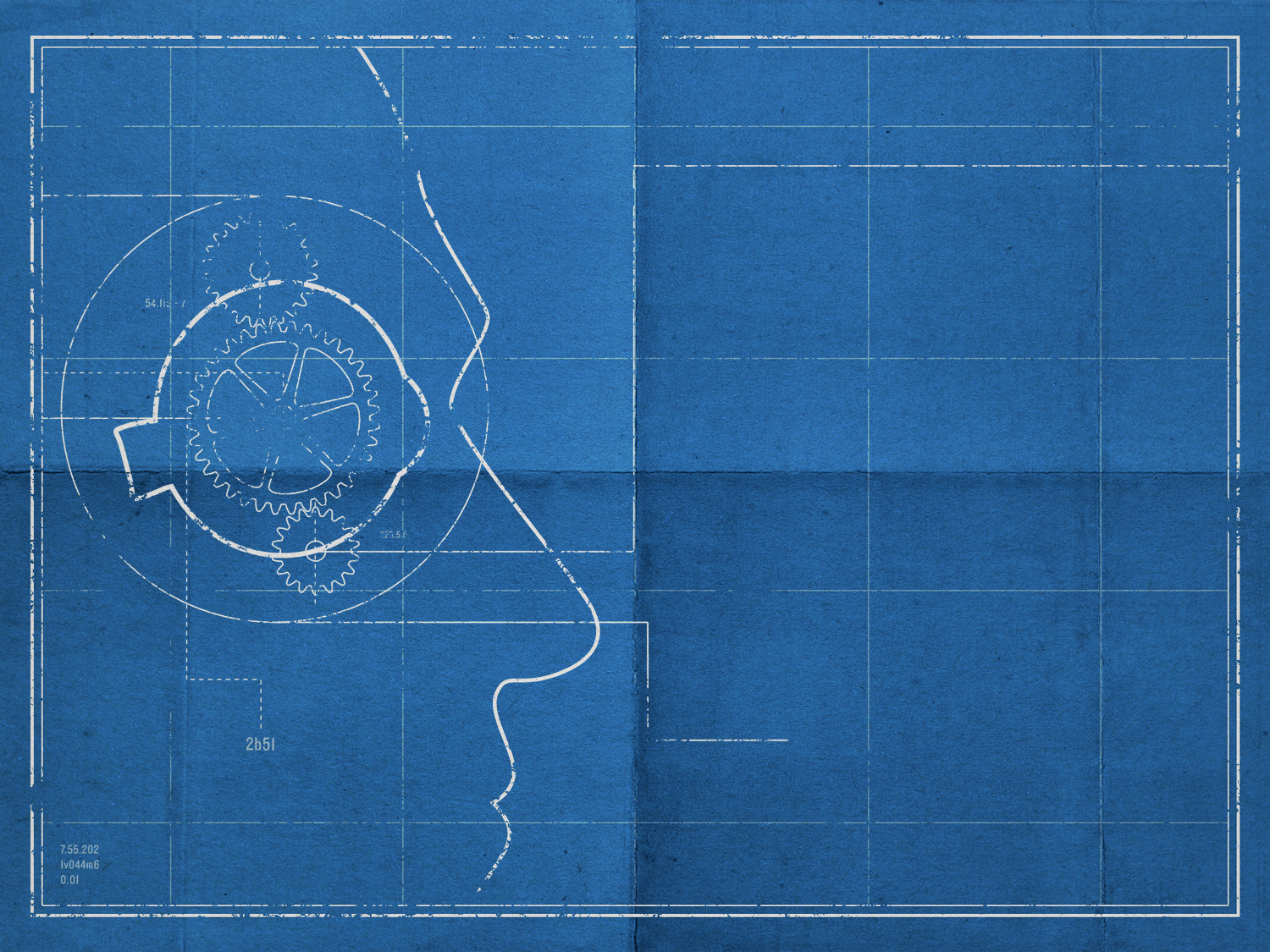
the
  scientist’s
  rational
  choice:
  CHRISTIANITY

Slide 3

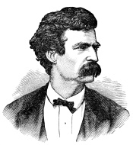
“Faith is believing what you know ain’t so.”

Slide 4
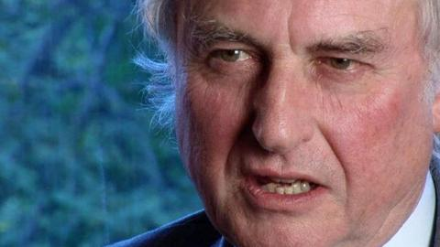
“Faith is the great cop-out, the great excuse to evade the need to think and evaluate evidence. Faith is belief in spite of, even perhaps because of, the lack of evidence.”

Slide 5
christianity
is the most rational choice.

Slide 6
which we heard…seen…touched.
did not preach cleverly devised myths.
they were eyewitnesses.
there were many convincing proofs.
nothing was done in a corner.

Slide 7
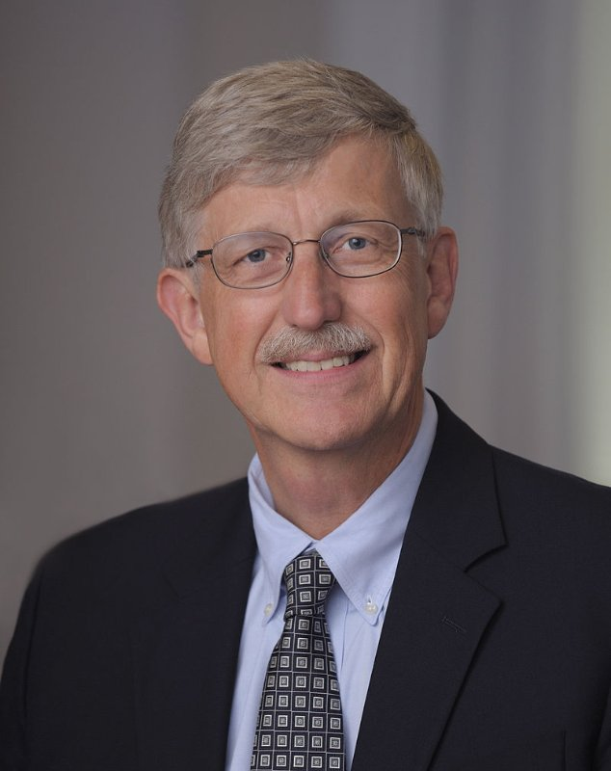
“I realized that my atheism had never really been based upon a real consideration of the evidence for or against the existence of God. To make a decision about something important without consideration of the evidence was not a good thing for a scientist.”

Slide 8
our responsibility:
to test its claims

Slide 9
christianity
worlds most falsifiable religion
HISTORY

Slide 10
christianity
not private
but public
HISTORY

Slide 11

“This is why you don’t have religions based on historic events. They are all, with the exception of Christianity, based on private encounters which cannot be falsified or subjective ideas which are beyond inquiry. The amazing thing about Christianity is that there is so much historic data to be tested. Christianity is, by far, the most falsifiable worldview there is. Yet, despite this, Christianity flourished in the first century among the very people who could test its claims. And even today, it calls on us to ‘come and see’ if the claims are true.”
“The taking away of God dissolves all.” John Locke
“If God does not exist, everything is permitted.” Fyodor Dostoevsky
Michael Patton

Slide 12
both testaments
the answers
the composition
BIBLE

Slide 13

FIRST CENTURY
MANUSCRIPTS: 3
WORKS OF TACITUS

Slide 14
HISTORY OF ROME
BY
VELLEIUS
PATERCULUS
FIRST CENTURY
MANUSCRIPTS: 1

Slide 15
INSTITUTES OF GAIUS
SECOND CENTURY
MANUSCRIPTS: 3

Slide 16
THE JEWISH WAR
BY
JOSEPHUS
FIRST CENTURY
MANUSCRIPTS: 50

Slide 17
THE JEWISH WAR
BY
JOSEPHUS
FIRST CENTURY
MANUSCRIPTS: 50

Slide 18
?
new testament
“The taking away of God dissolves all.” John Locke
5800 +
“If God does not exist, everything is permitted.” Fyodor Dostoevsky

Slide 19
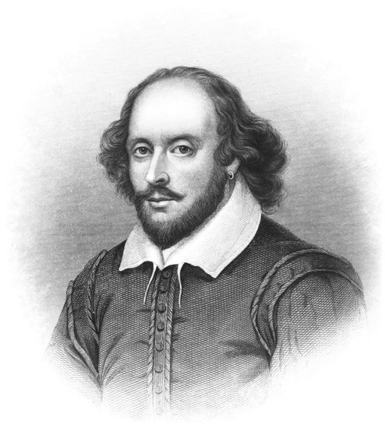

Slide 20
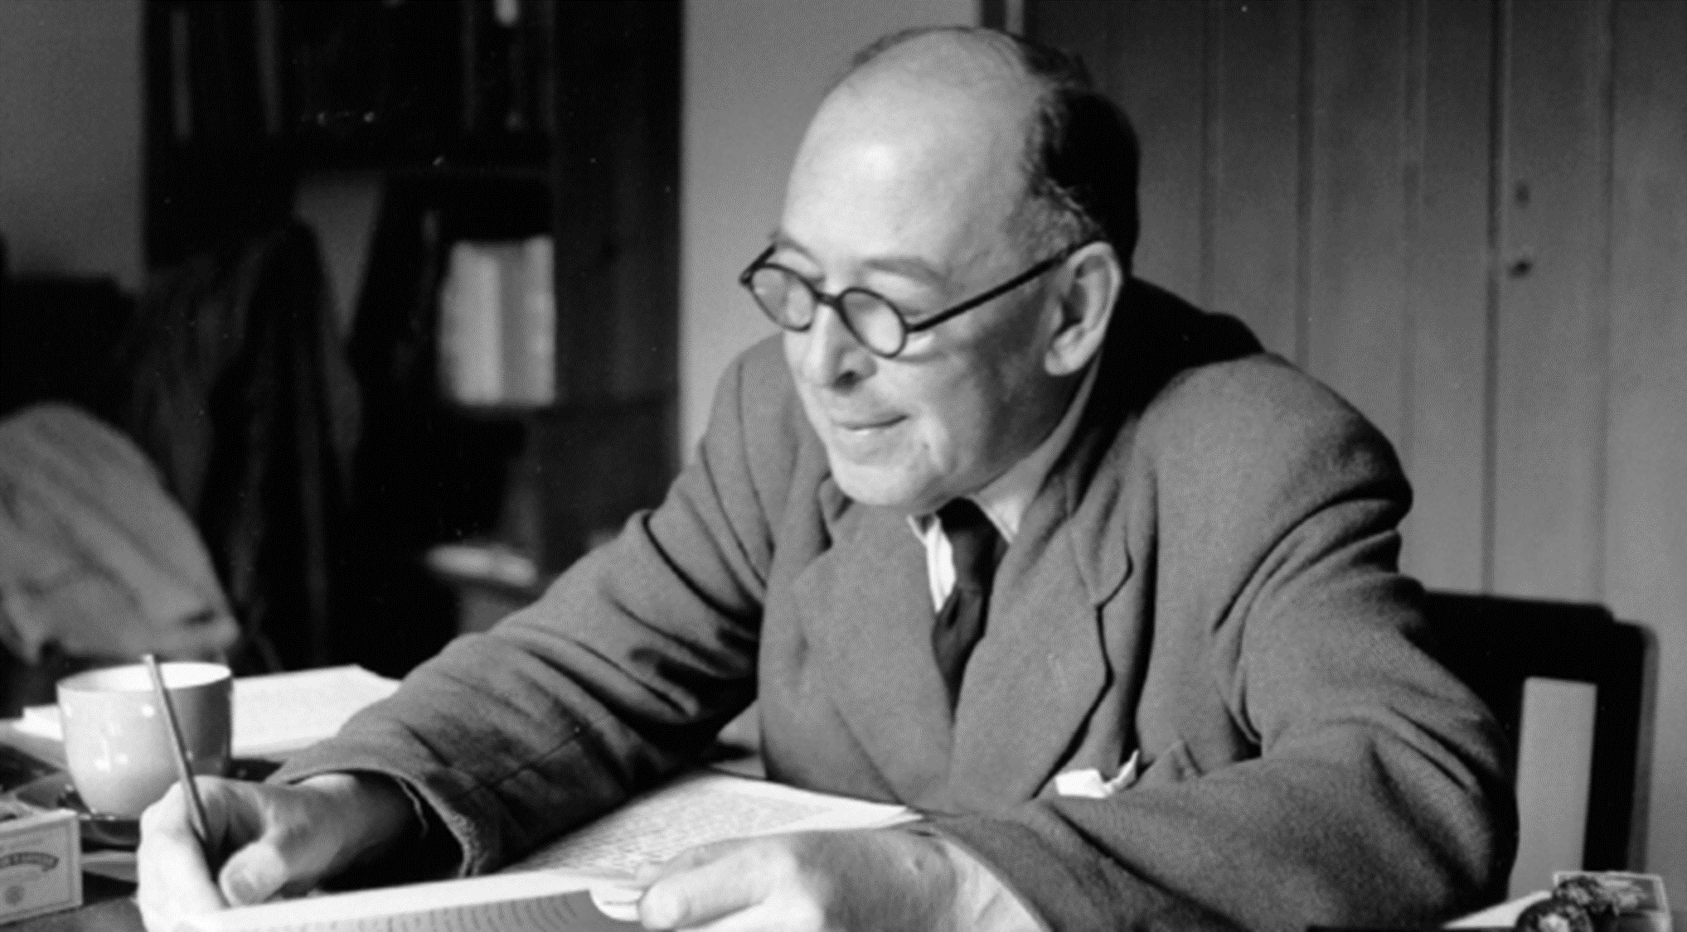
“I have been reading poems, romances, vision literature, legends, and myths all my life. I know what they are like. I know none of them are like this. Of this [gospel] text there are only two possible views. Either this is reportage…or else, some unknown [ancient] writer…without known predecessors or successors, suddenly anticipated the whole technique of modern novelistic, realistic narrative.”

Slide 21
jesus of nazareth
godman
sacrifice
different than all
FOUNDER

Slide 22
“I did look at the world’s religions, trying to understand their foundations, and realized a lot of what they had to say is overlapping. There are great similarities in the terms of the principles and the things we are all called to do on the basis of these religions, but there are also differences. This investigation of comparative religions came at a time when I was feeling particularly worried about the way my own exploration of faith was going – because just as I began to realize that God was a reality, I was also realizing how far short I fell of what God was calling me to do…

Slide 23
…I would try to change that by living up to the standards of the moral law, and I would fail over and over again. This is when I learned about Jesus. The person of Jesus Christ is different from every other figure I had encountered in world religions. He not only claimed to know about God but to be God. And he died on the Cross in a substitutionary way. That strange sacrifice became exactly what I had been looking for – a pathway to allow me to approach God, despite all my imperfections.”

Slide 24
why atheism is irrational
it lives against history
it believes fine-tuning is accidental
it lives inconsistently
it claims power it does not have

Slide 25
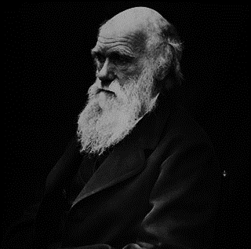
“the universe is not the result of chance”
“I feel compelled to look to a First Cause having an intelligent mind in some degree analogous to that of man”

Slide 26
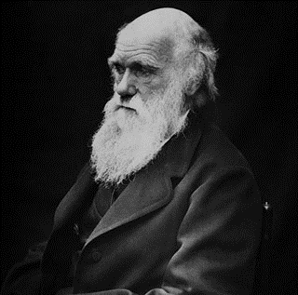
“But then arises the doubt – can the mind of man, which has, as I fully believe, been developed from a mind as low as that possessed by the lowest animal, be trusted when it draws such grand conclusions?”

Slide 27
“Most critically, I wanted to determine if belief was really something that somebody like me, who imagined myself completely driven by reason, could, in fact, embrace as well. Over those two years, I discovered that I had missed out on a profoundly compelling series of arguments which indicate that atheism is, in fact, the least rational of all choices.”

