Slide 2
SCIENCE
MIRACLES
RESURRECTION

Slide 3
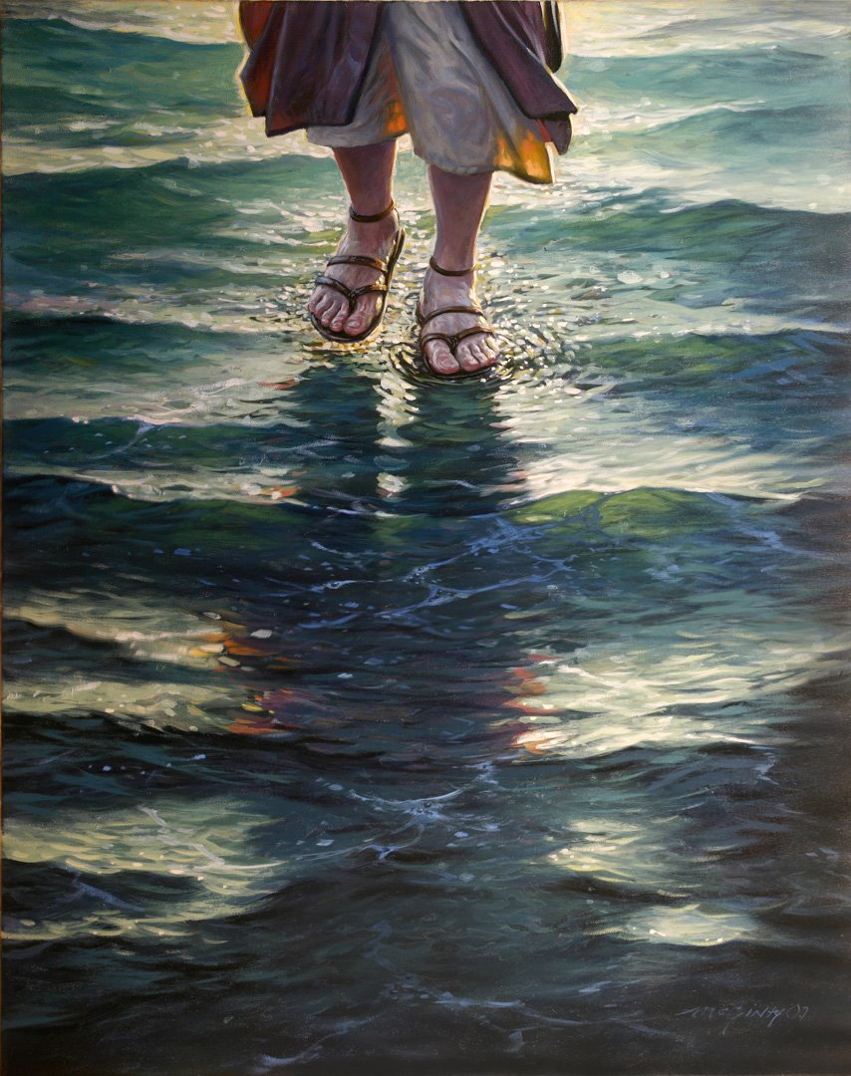

Slide 6
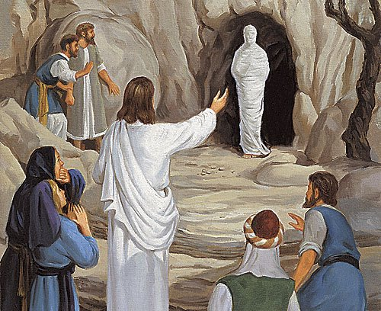

Slide 7
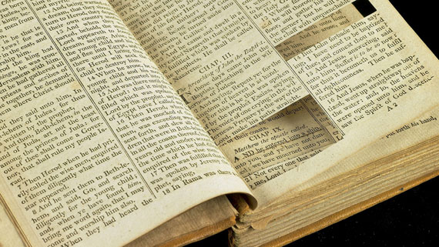
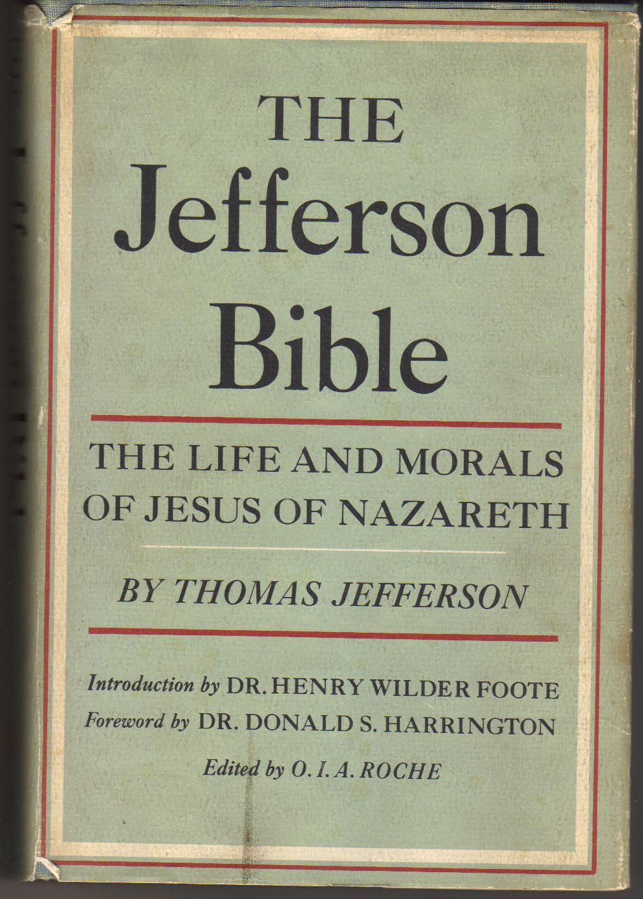

Slide 8
science has proven there is no such thing as miracles.

Slide 9
Science has disproven miracles. Christianity is based on miracles.
Therefore science has disproven Christianity.
“The taking away of God dissolves all.” John Locke
“If God does not exist, everything is permitted.” Fyodor Dostoevsky

Slide 10
“My faith can be summed up in this one [alleged] paradox: I believe in science, and I believe in God … I plan to continue to testify to both.”
hugh siefken
nuclear physicist

Slide 11
miracle:
an effect or extraordinary event in the physical world that surpasses all known human or natural powers and is ascribed to a supernatural cause.

Slide 12
miracle
or magic

Slide 13
miracles:
invite verification
are practical
enhance human dignity
point to God
are requested

Slide 14
“Miracles are not to be interpreted as divine acts against the laws of nature (for those laws are themselves expressions of God’s will) but as more profound revelations of the character of the divine relationship to creation. To be credible, miracles must convey a deeper understanding than could have been obtained without them.”
Sir John Polkinghorne
“The taking away of God dissolves all.” John Locke
“If God does not exist, everything is permitted.” Fyodor Dostoevsky

Slide 15
“it is one thing to say that science is only equipped to test for natural causes and cannot speak to any others. It is quite another to insist that science proves that no other causes could possibly exist.”
Dr. Timothy Keller

Slide 16
science history
miracles
resurrection.

Slide 17
“science studies the repeatable, while history studies the unrepeatable. Caesar only crossed the Rubicon once, and if he’d crossed it again it would have meant something different the second time. There was, and could be, only one first landing on the moon. The fall of the second Jerusalem Temple took place in AD 70 and never happened again. Historians don’t, of course, see this as a problem and are usually not shy about declaring that these events certainly took place even though we can’t repeat them in a laboratory.”
“The taking away of God dissolves all.” John Locke
“If God does not exist, everything is permitted.” Fyodor Dostoevsky
n.t. wright

Slide 18
resurrection
or
resuscitation

Slide 19
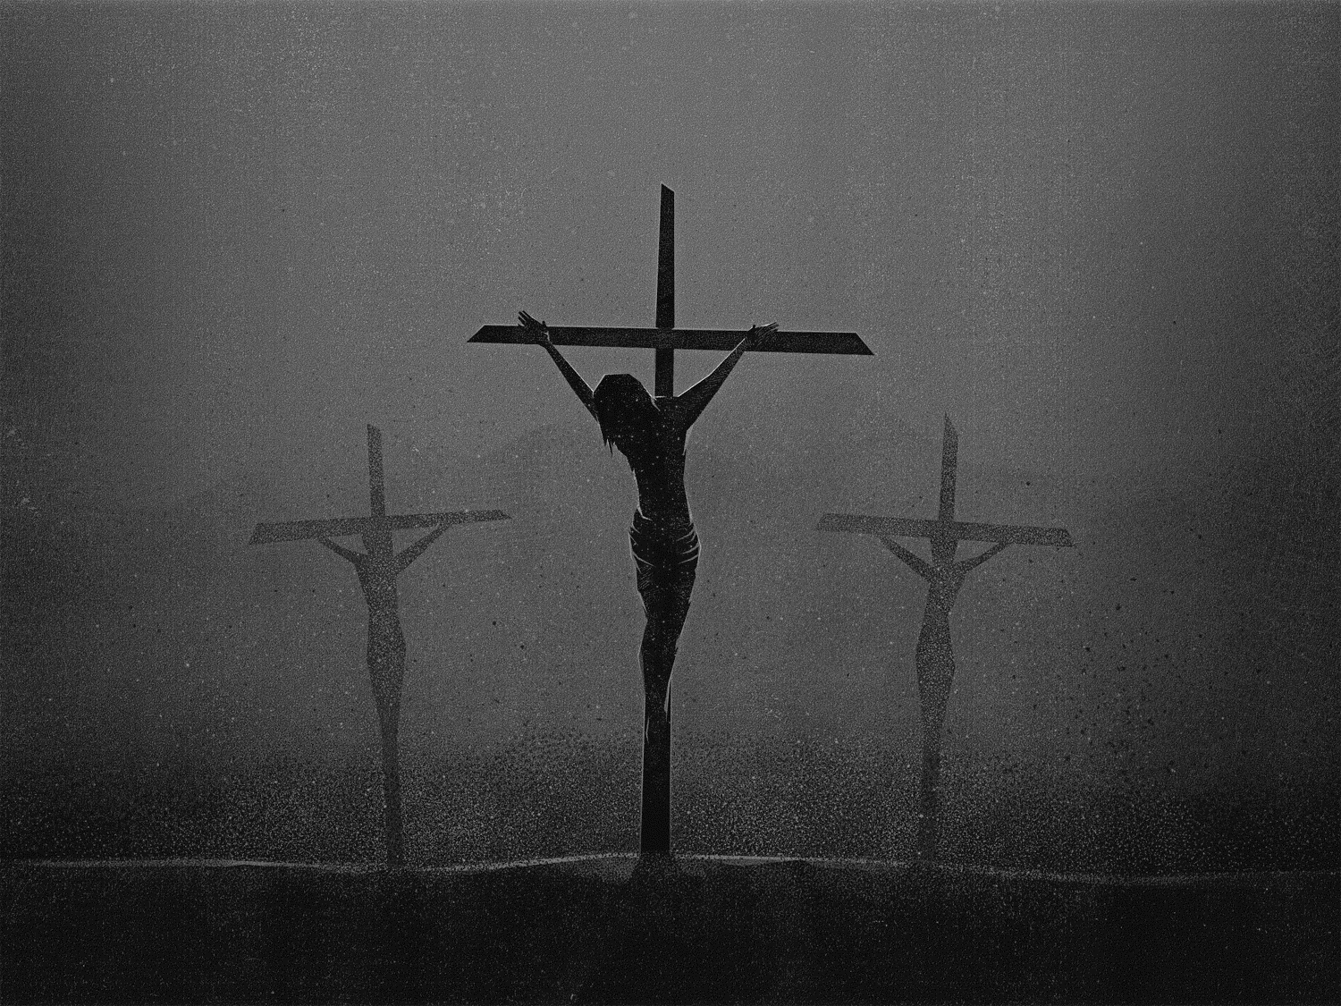
hematidrosis
hypovolemic shock
respiratory acidosis
pericardial effusion

Slide 20
There is absolutely no doubt that Jesus was dead.
Dr. Alexander Metherell

Slide 21
“As far as I’m concerned, the historian may and must say that all other explanations for why Christianity arose, and why it took the shape it did, are far less convincing as historical explanations than the one the early Christians themselves offer: that Jesus really did rise from the dead…leaving an empty tomb behind him.”
“The taking away of God dissolves all.” John Locke
“If God does not exist, everything is permitted.” Fyodor Dostoevsky
n.t. wright

Slide 22
unlikely events:
the empty tomb
eye-witness testimony

Slide 23
Now I would remind you, brothers, of the gospel I preached to you, which you received, in which you stand, and by which you are being saved, if you hold fast to the word I preached to you—unless you believed in vain. For I delivered to you as of first importance what I also received: that Christ died for our sins in accordance with the Scriptures, that he was buried, that he was raised on the third day in accordance with the Scriptures, and that he appeared to Cephas, then to the twelve. Then he appeared to more than five hundred brothers at one time, most of whom are still alive, though some have fallen asleep. Then he appeared to James, then to all the apostles. Last of all, as to one untimely born, he appeared also to me.
1 Corinthians 15.1-8

Slide 24
unlikely events:
the empty tomb
eye-witness testimony
women’s testimony
christianity itself
what other
plausible cause is there
?

Slide 25
“So you’ve got an unlikely story, an unimpressed audience, risks of an untimely death, and a totally uncommon cast of characters. The claim is the disciples fabricated a culturally unpopular idea (resurrection), using people who do not count as witnesses for it (women), presented to a host of unbelieving followers (doubting disciples) as the way to persuade a doubting audience. Not one of these elements passes the smell test for the fabrication theory. And they do nothing to make a dent in the much more reasonable account – even if no more believable to a doubting mind – that Jesus, by the most astounding earthly miracle of all, came up out of a grace in a resurrected body.”
Andreas Köstenberger

