Slide 2
The
Insufficiency
of Science

Slide 3
“The taking away of God dissolves all.” John Locke
“If God does not exist, everything is permitted.” Fyodor Dostoevsky

Slide 4
“The final decisive edge enjoyed by scientific naturalism will come from its capacity to explain traditional religion, its chief competition, as a wholly material phenomenon. Theology is not likely to survive as an independent intellectual discipline.” E. O. Wilson
“The taking away of God dissolves all.” John Locke
“If God does not exist, everything is permitted.” Fyodor Dostoevsky

Slide 5
atheism
“could replicate the worse vices of religion”

Slide 6
He will render to each one according to his works: to those who by patience in well-doing seek for glory and honor and immortality, he will give eternal life; but for those who are self-seeking and do not obey the truth, but obey unrighteousness, there will be wrath and fury. There will be tribulation and distress for every human being who does evil, the Jew first and also the Greek, but glory and honor and peace for everyone who does good, the Jew first and also the Greek. For God shows no partiality.
Romans 2.6-16

Slide 7
For all who have sinned without the law will also perish without the law, and all who have sinned under the law will be judged by the law. For it is not the hearers of the law who are righteous before God, but the doers of the law who will be justified. For when Gentiles, who do not have the law, by nature do what the law requires, they are a law to themselves, even though they do not have the law. They show that the work of the law is written on their hearts, while their conscience also bears witness, and their conflicting thoughts accuse or even excuse them on that day when, according to my gospel, God judges the secrets of men by Christ Jesus.
Romans 2.6-16

Slide 8
“‘Morals’ are simply a product of evolution.”
denial #1

Slide 9
“I do not, for a minute, believe that our conviction that torturing children is either some kind of curious, disguised genetic strategy or just a convention of our society….It is a fact about the world that torturing children is wrong.”
Sir John Polkinghorne
Theoretical Physicist
“The taking away of God dissolves all.” John Locke
“If God does not exist, everything is permitted.” Fyodor Dostoevsky

Slide 10
“There are no moral absolutes; it’s all subjective and only relative.”
denial #2

Slide 11
worldview:
a comprehensive conception or image of the universe and of humanity’s relation to it.

Slide 12
A scientist will attend a political meeting and complain that the natives are treated as beasts, but then will attend a scientific meeting only to prove that he is one.
g.k. chesterton

Slide 13
I do not know how to ‘justify’ or ‘defend’ social democracy … in a large philosophical way.
Richard Rorty
Philosopher of Democracy

Slide 14
I blame people, I give people credit.
…it is an inconsistency that we sort of have to live with, otherwise life would be intolerable.
Richard Dawkins
Outspoken Atheist

Slide 15
The most profound geniuses of Rome and Greece [never came up with the idea of equal rights]. Jesus Christ had to come to earth to make it understand that all members of the human species are naturally alike and equal.
Alexis de Tocqueville
Political Thinker

Slide 16
Another Christian concept … has passed even more deeply into the tissue of modernity: the concept of the ‘equality of souls before God.’ This concept furnished the prototype of all theories of equal rights.
Friedrich Nietzsche
Atheistic Philosopher

Slide 17
According to Christianity, we were all ‘brothers,’ on the same level as creatures of God….Christianity is the first universalist ethos.
Luc Ferry
French Philosopher

Slide 18
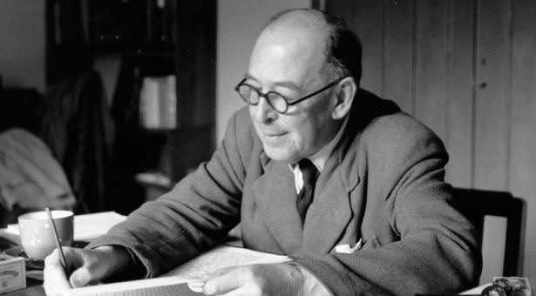
Right and Wrong as a Clue to the Meaning of the Universe

Slide 19
“If there was a controlling power outside of the universe, it could not show itself to us as one of the facts inside the universe – no more than the architect of a house could actually be a wall or staircase or fireplace in that house. The only way in which we could expect it to show itself would be inside ourselves as an influence or a command trying to get us to behave in a certain way. And that is just what we do find inside ourselves. Surely this ought to arouse our suspicions?”
“The taking away of God dissolves all.” John Locke
“If God does not exist, everything is permitted.” Fyodor Dostoevsky

Slide 20
?
why dont we change
’

Slide 21
“a belief in nothingness after death – the huge solace of thinking that for our betrayals, greed, cowardice, murders we are not going to be judged.”
Czesław Miłosz

Slide 22
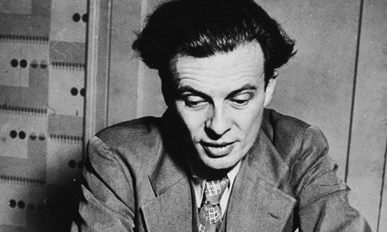

Slide 23
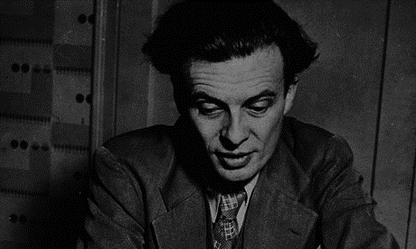
“I had motives for not wanting the world to have meaning; consequently assumed it had none, and was able without any difficulty to find satisfying reasons for this assumption. The philosopher who finds no meaning in the world is not concerned exclusively with a problem in pure metaphysics; he is also concerned to prove there is no valid reason why he personally should not do as he wants to do… For myself, as no doubt for most of my contemporaries, the philosophy of meaninglessness was essentially an instrument of liberation. The liberation we desired was simultaneously liberation from a certain political and economic system and liberation from a certain system of morality. We objected to the morality because it interfered with our sexual freedom.”

