Slide 2
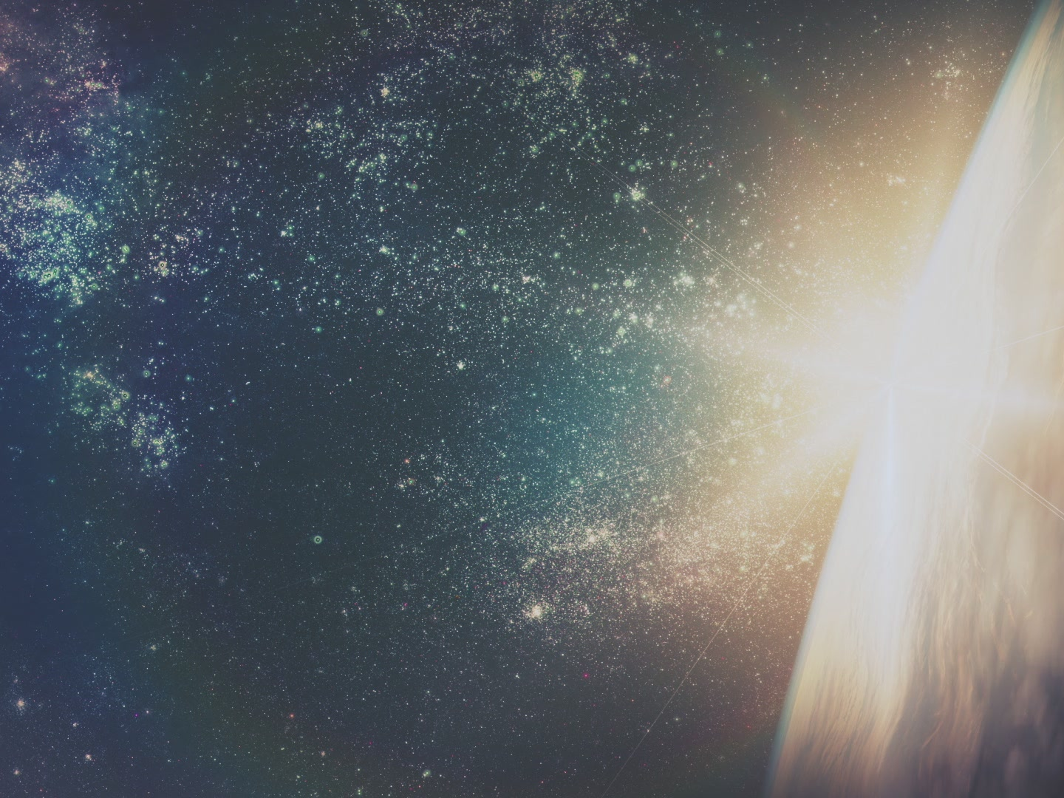
science’s case
for a creator:
the fine-tuning
of the cosmos

Slide 3
“These mysterious numbers … are like the knobs on God’s control console, and they seem almost miraculously tuned to allow life”

Slide 4
“my atheism was greatly shaken by these discoveries.”
Fred Hoyle
Astronomer

Slide 5
“The appearance of design is overwhelming.”
Paul Davies
Theoretical Physicist

Slide 6
“The more we get to know about our universe, the more the hypothesis that there is a Creator gains in credibility as the best explanation of why we’re here.”
John Lennox
Professor of Mathematics

Slide 7
“Without question the fine-tuning argument was the most powerful argument of the other side.”
Christopher Hitchens
Outspoken Atheist

Slide 8
1,000,000,000,000,000,000,000,000,000
1,000,000,000,000,000,000,000,000

Slide 9
200+

Slide 10
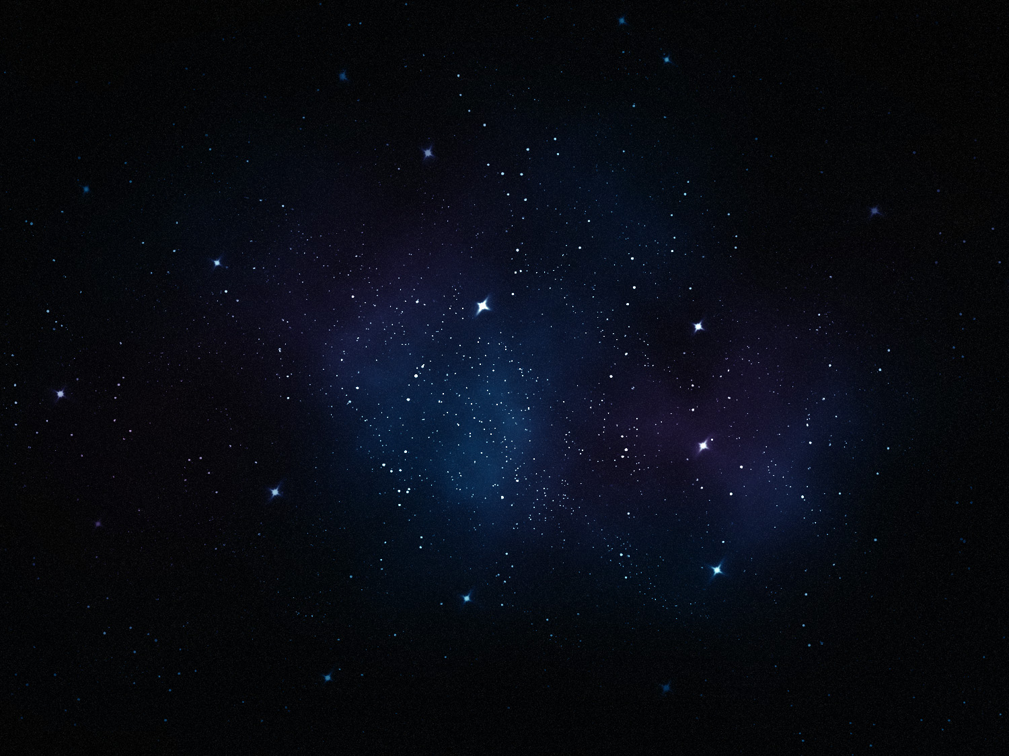
Gravity
Electromagnetic force
Strong nuclear force
Weak nuclear force

Slide 13
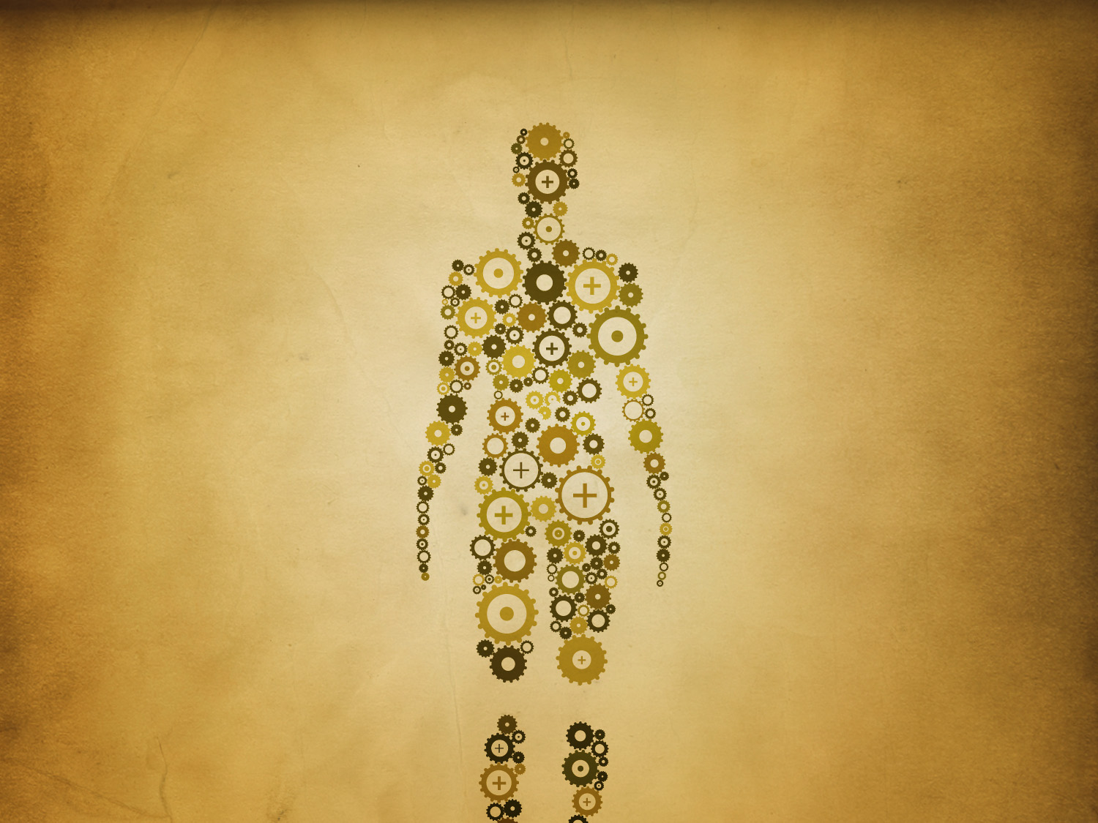
dr. francis collins
dr. michael egnor

Slide 14
“filter that protects the delicate capillaries from the pulsating force of the heartbeat ‘is a finely tuned mechanism analogous to vibration dampers widely used in engineering. In fact, most of what I needed to know was not in biology textbooks but in engineering textbooks.’”
- Michael Egnor

Slide 15
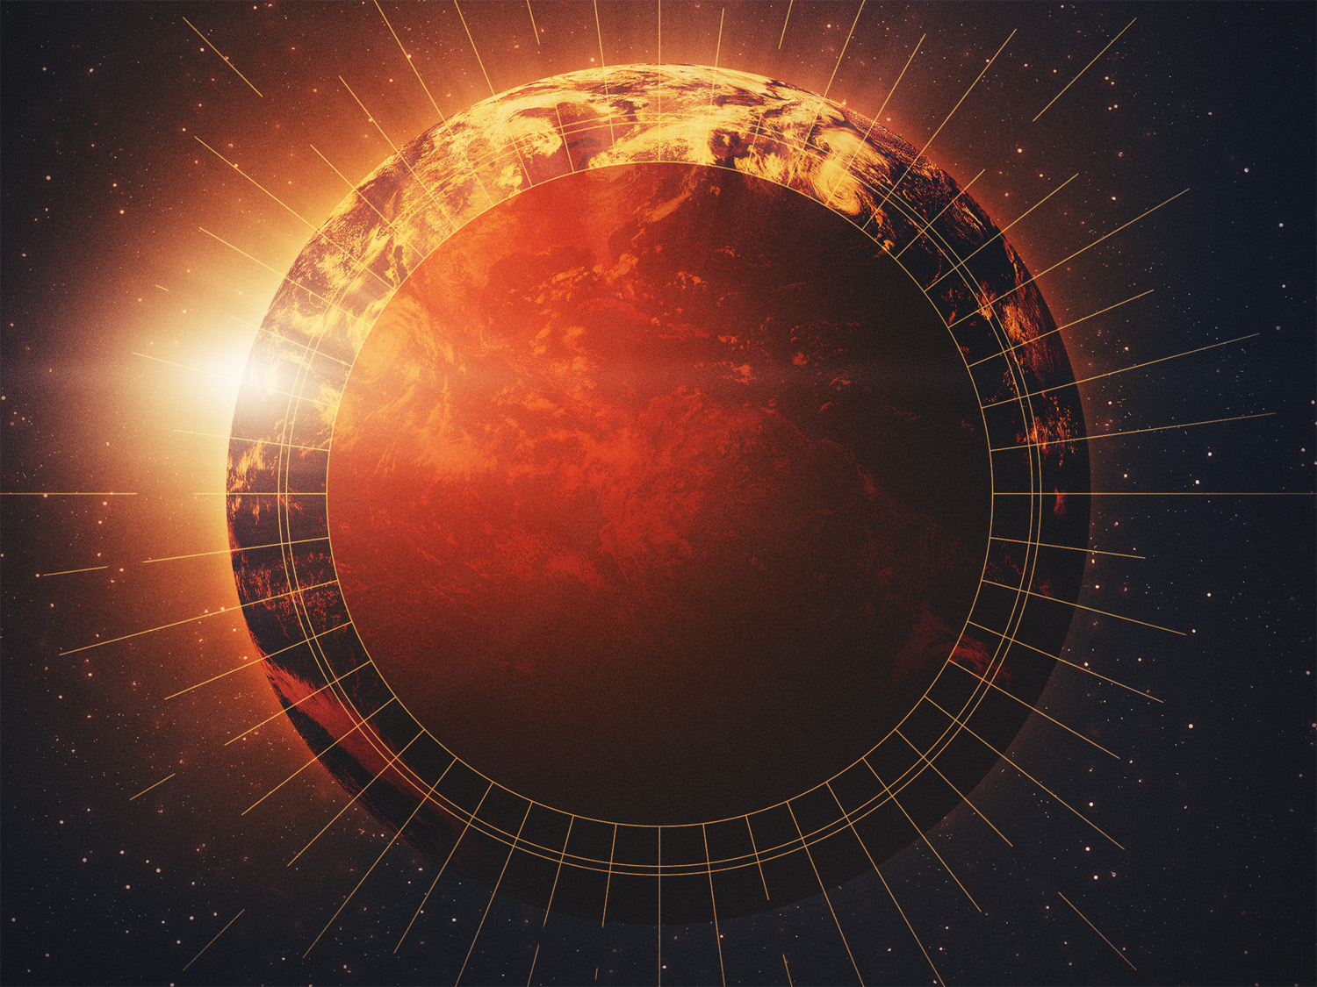

Slide 16
why is math so unreasonably effective
?“

Slide 17
Life-prohibiting
Life-supporting

Slide 18
The heavens declare the glory of God, and the sky above proclaims his handiwork. Day to day pours out speech, and night to night reveals knowledge. There is no speech, nor are there words, whose voice is not heard. Their voice goes out through all the earth, and their words to the end of the world. In them he has set a tent for the sun, which comes out like a bridegroom leaving his chamber, and, like a strong man, runs its course with joy. Its rising is from the end of the heavens, and its circuit to the end of them, and there is nothing hidden from its heat.
Psalm 19.1-6

Slide 19
“When we see something moved by machinery, like an orrery [model of the planetary system] or clock or many other such things, we do not doubt that these contrivances are the work of reason … When therefore we behold the whole compass of heaven moving with revolutions of marvelous velocity and … perfect regularity …, how can we doubt that all this is effected not merely by reason, but by a reason that is transcendent and divine?” (Cicero)

Slide 20
For the wrath of God is revealed from heaven against all ungodliness and unrighteousness of men, who by their unrighteousness suppress the truth. For what can be known about God is plain to them, because God has shown it to them. For his invisible attributes, namely, his eternal power and divine nature, have been clearly perceived, ever since the creation of the world, in the things that have been made. So they are without excuse. For although they knew God, they did not honor him as God or give thanks to him, but they became futile in their thinking, and their foolish hearts were darkened.
Romans 1.18-25

Slide 21
Claiming to be wise, they became fools, and exchanged the glory of the immortal God for images resembling mortal man and birds and animals and creeping things. Therefore God gave them up in the lusts of their hearts to impurity, to the dishonoring of their bodies among themselves, because they exchanged the truth about God for a lie and worshiped and served the creature rather than the Creator, who is blessed forever! Amen.
Romans 1.18-25

Slide 22
“I want atheism to be true … I don’t want there to be a God; I don’t want the universe to be like that.”
“…fear of religion itself…”
“…cosmic authority problem…”
Thomas Nagel
Philosophy Professor

