Slide 2

SCIENCE VS CHRISTIANITY
competition
cooperation
OR
?

Slide 3

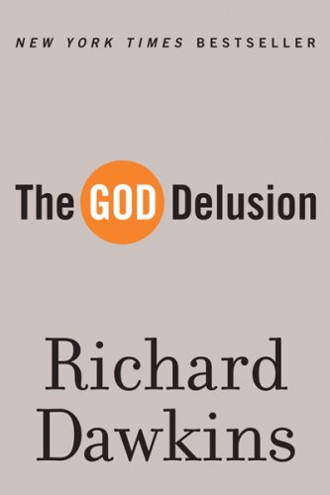
religion and science
are at war!

Slide 4

“One of the reasons for this perception is that the media needs to report news events as stories with protagonists and antagonists. It gives wide publicity to battles between secular and religious people over the teaching of evolution in schools, stem-cell research, in vitro fertilization, and many other areas of medicine and science. These battles give credibility to the claims of Dawkins, Harris and others that it is either-or – you either be scientific and rational or religious.”

Slide 5

Has there always been a division between science and faith?
history says “No.”

Slide 6
The Enlightenment: the movement where those “enlightened” walked away from traditional forms of authority and instead emphasized reason, analysis and individualism.

Slide 7


Ffaith versus science
is a relatively new development
“

Slide 8

All early scientists, like Newton, were religious in one way or another.
Paul Davies
Theoretical Physicist

Slide 9
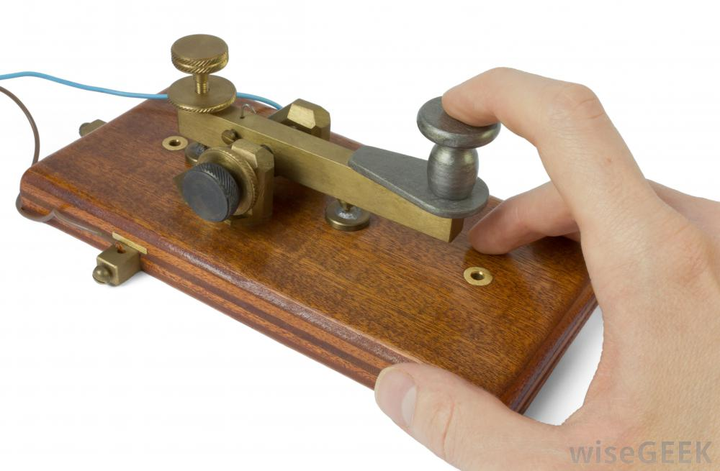
“What Hath God Wrought?”
- Samuel Morse

Slide 10
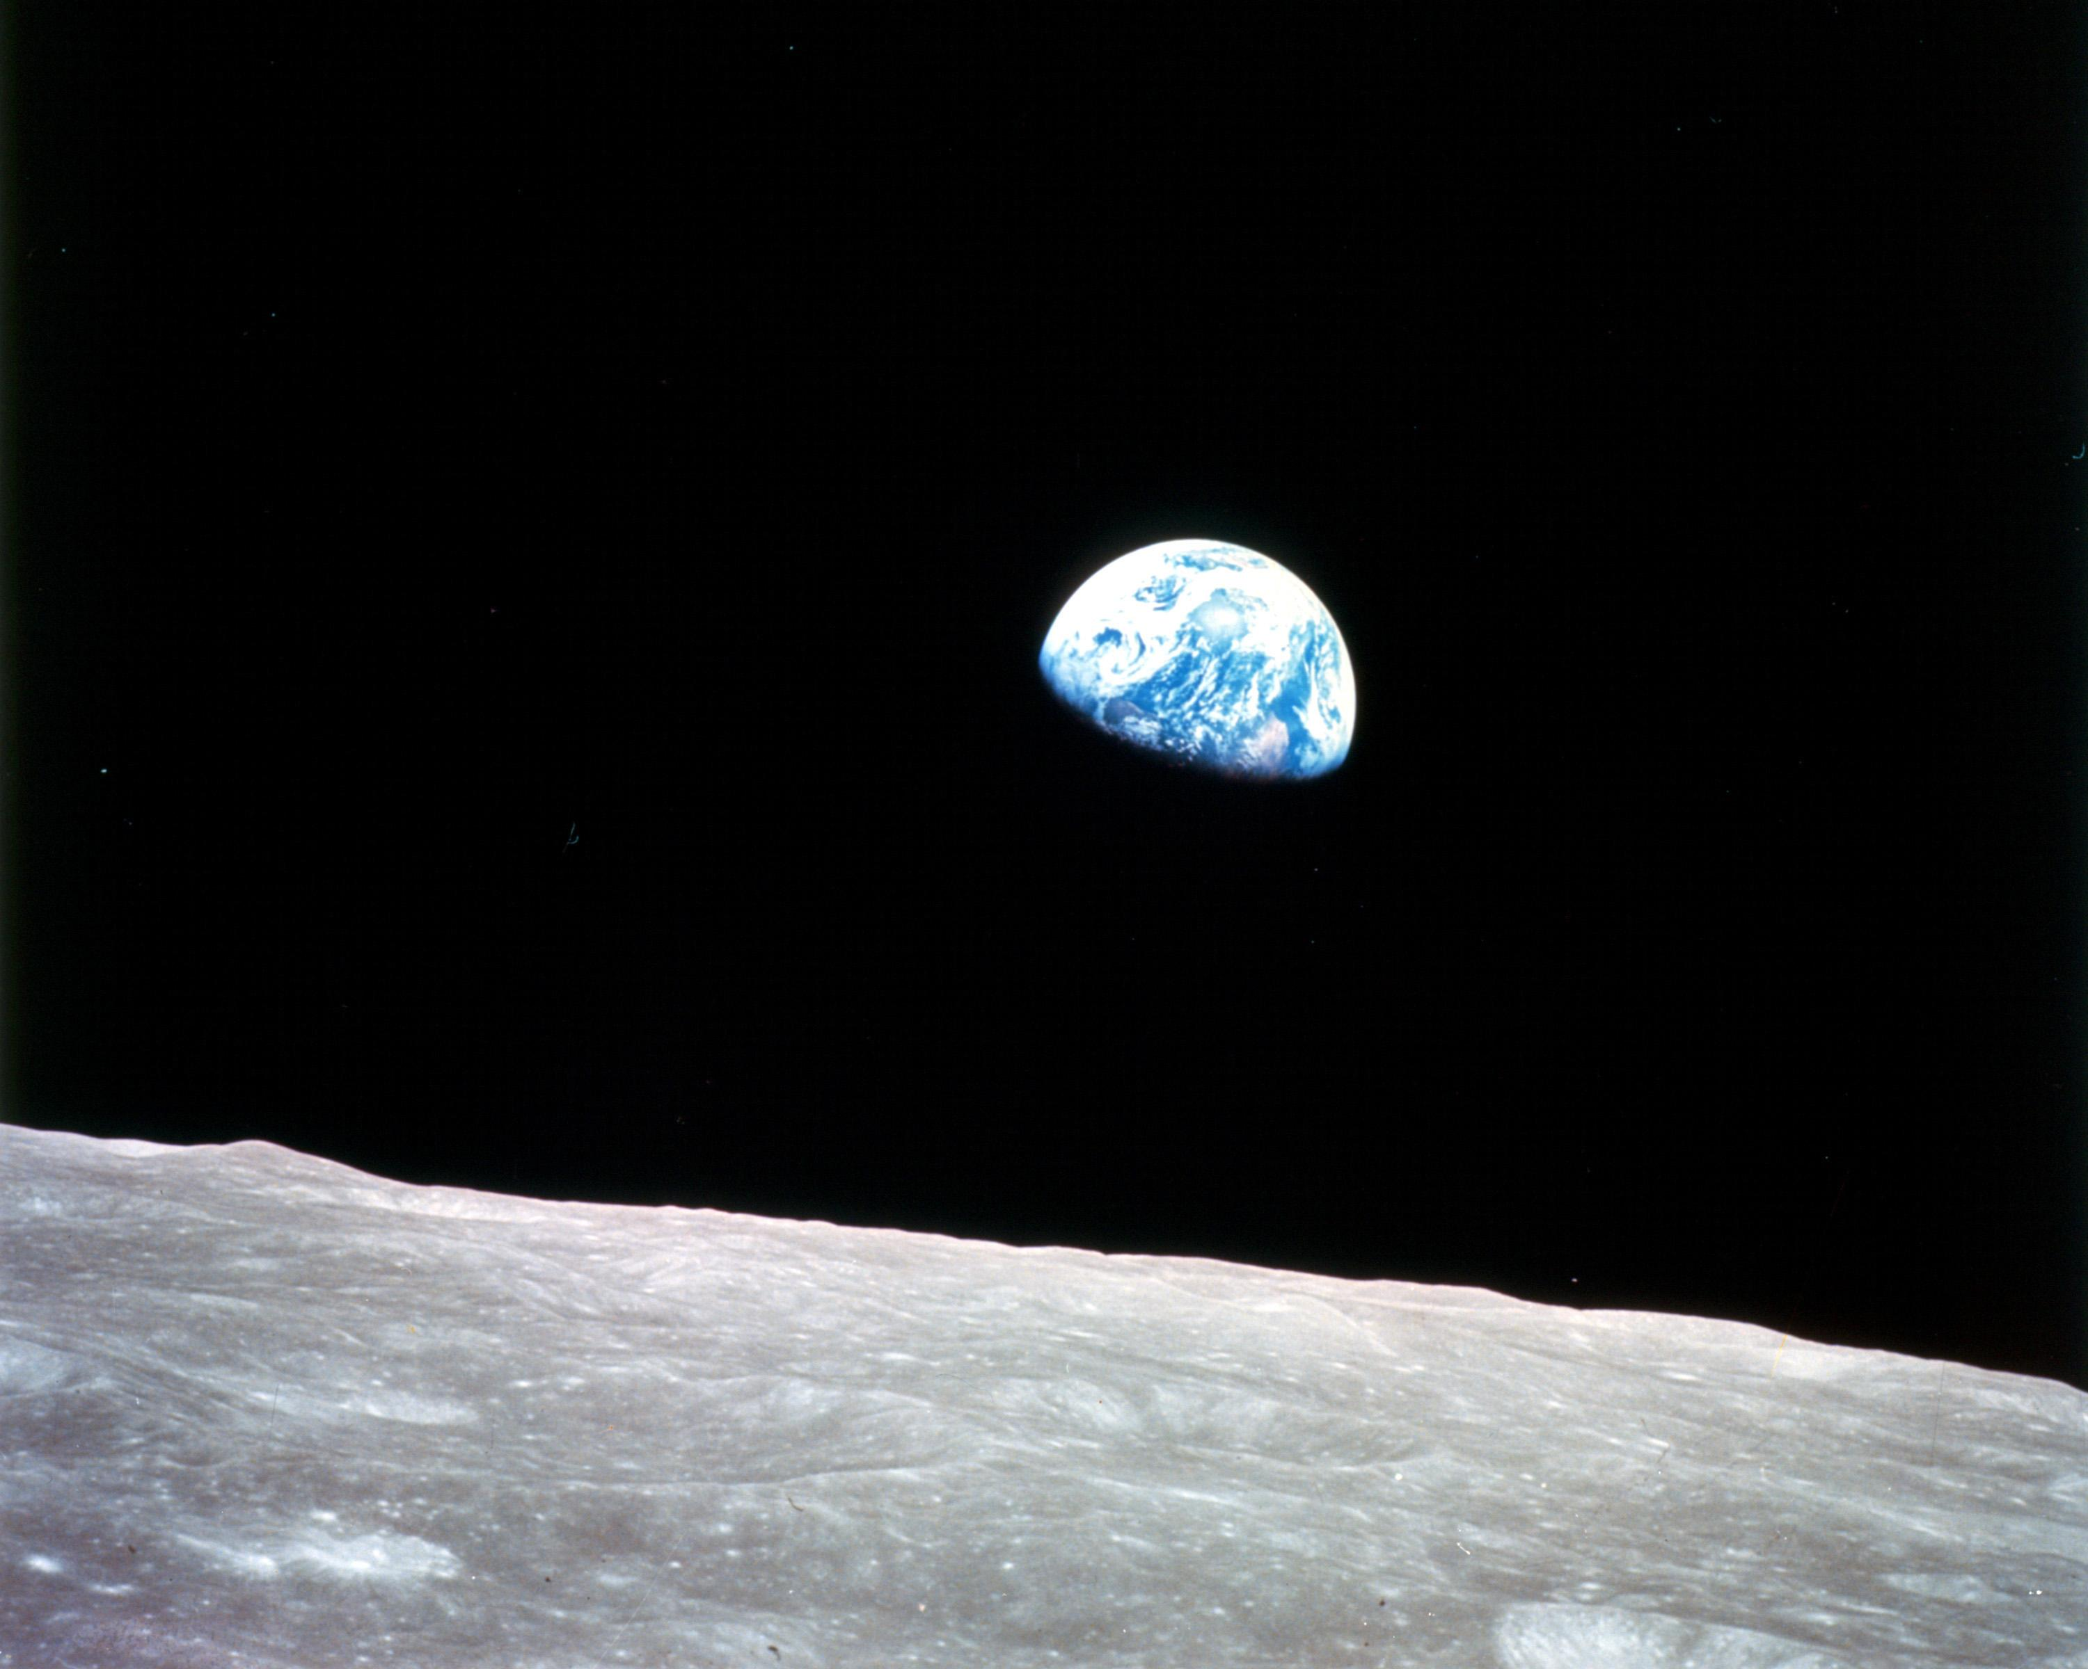
“apollo eight read the first chapter of genesis

Slide 11
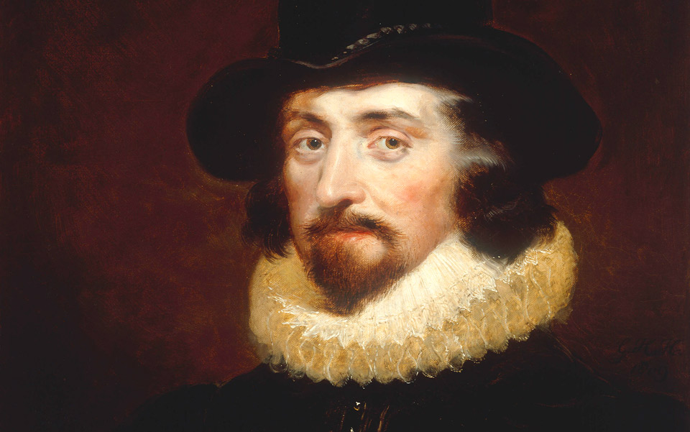
It is the glory of God to conceal things,
but the glory of kings is to search things out. Proverbs 25.2
“What Hath God Wrought?”
- Samuel Morse

Slide 12
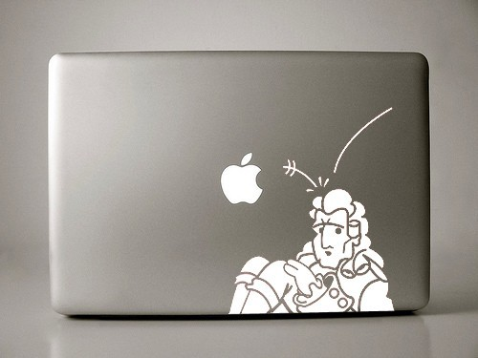

Slide 13
faith vs science

Slide 14
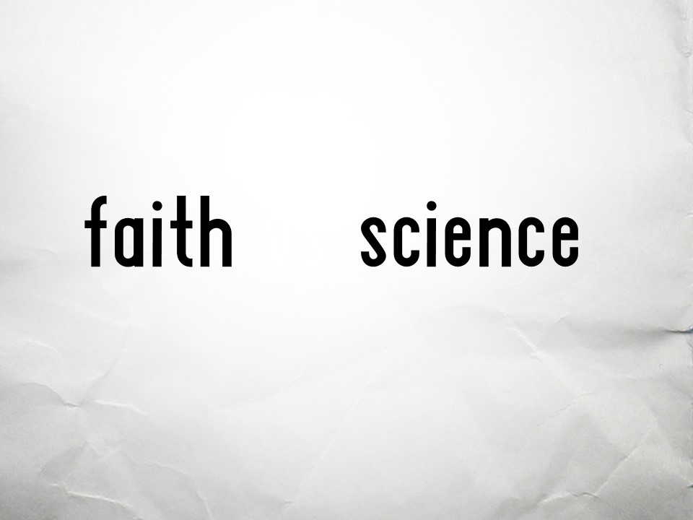
&

Slide 15
science answers
christianity answers
how?
why?

Slide 16
“Usually, even a non-Christian knows something about the earth, the heavens, and the other elements of this world, about the motion and orbit of the stars and even their size and relative positions, about the predictable eclipses of the sun and moon, the cycles of the years and the seasons, about the kinds of animals, shrubs, stones, and so forth, and this knowledge he hold to as being certain from reason and experience. Now, it is a disgraceful and dangerous thing for an infidel to hear a Christian, presumably giving the meaning of Holy Scripture, talking nonsense on these topics; and we should take all means to prevent such an embarrassing situation, in which people show up vast ignorance in a Christian and laugh it to scorn…

Slide 17
“The shame is not so much that an ignorant individual is derided, but that people outside the household of faith think our sacred writers held such opinions, and, to the great loss of those for whose salvation we toil, the writers of our Scripture are criticized and rejected as unlearned men. If they find a Christian mistaken in a field which they themselves know well and hear him maintaining his foolish opinions about our books, how are they going to believe those books in matters concerning the resurrection of the dead, the hope of eternal life, and the kingdom of heaven, when they think their pages are full of…

Slide 18
…falsehoods and on facts which they themselves have learnt from experience and the light of reason? Reckless and incompetent expounders of Holy Scripture bring untold trouble and sorrow on their wiser brethren when they are caught in one of their mischievous false opinions and are taken to task by those who are not bound by the authority of our sacred books. For then, to defend their utterly foolish and obviously untrue statements, they will try to call upon Holy Scripture for proof and even recite from memory many passages which they think support their position, although they understand neither what they say nor the things about which they make assertion.”

Slide 19
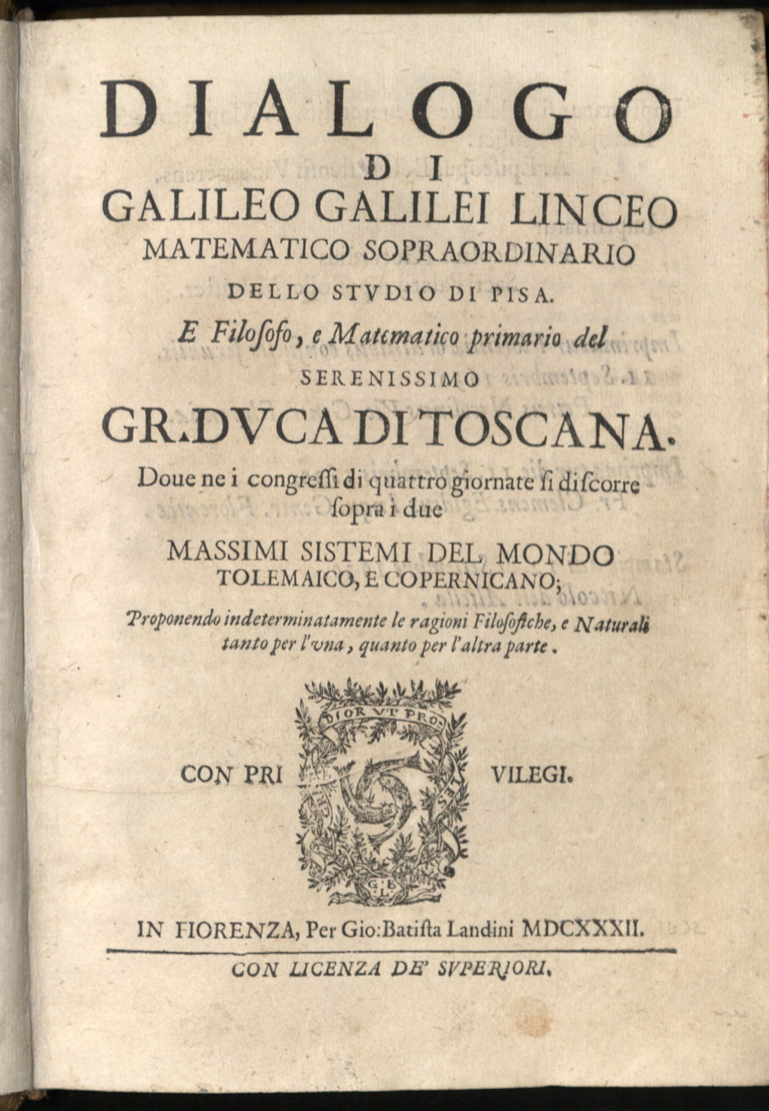
faith vs science

Slide 20
I do not feel obliged to believe that the same God who has endowed us with sense, reason, and intellect has intended us to forgo their use.
Galileo Galilei
Astronomer

Slide 21
"Then he reasoned to himself: 'The light is not a liquid; otherwise, if it were liquid, it could flow from one vessel to another and it would have waves and vibrations caused by the wind, as water has. Sunlight is not a fire, because if it were a fire, it could be extinguished by water. Sunlight is not a spirit because it can be observed, and yet it is not a body because one cannot move it from one place to another. Therefore, since sunlight is neither liquid, nor fire, nor spirit, nor body, sunlight is – ‘nothing.' "Thus the man lost both his intellect and his eyesight while arriving at these conclusions and staring intently at the sun. By the time he was completely blind, he had also become completely assured that the sun did not exist."

Slide 22
why we need
christianity

Slide 23
“science takes things apart to see how they work, but religion puts things together to see what they mean.”
J- jonathan sacks

